Slide 1



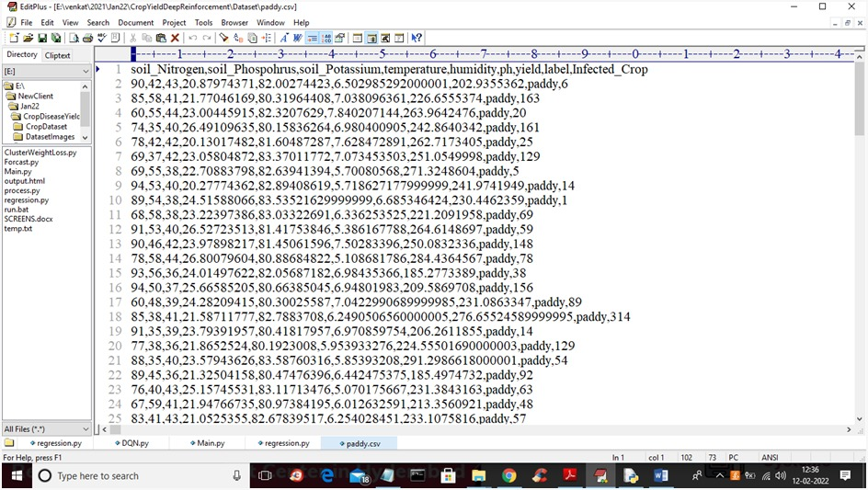
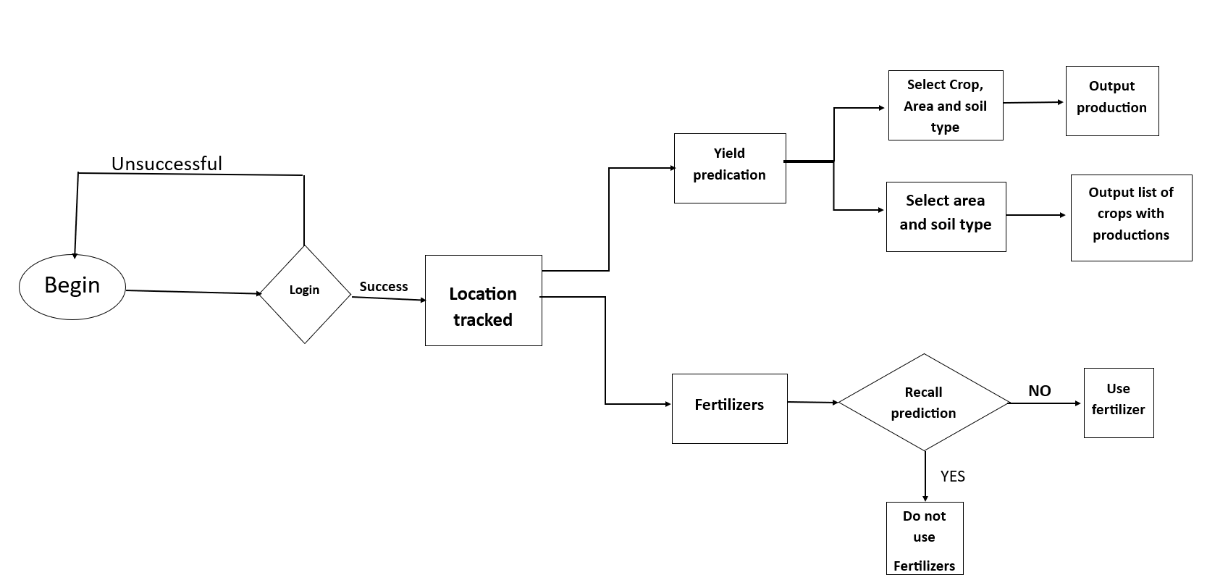
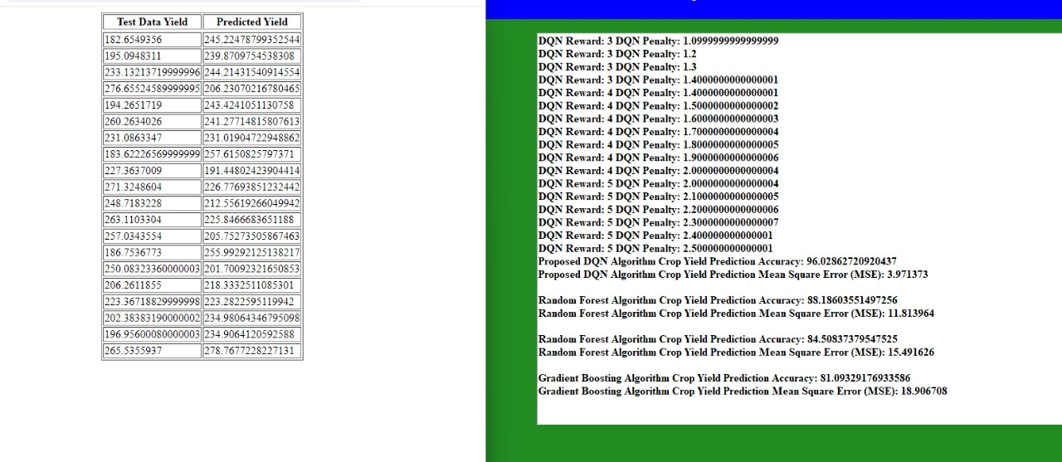
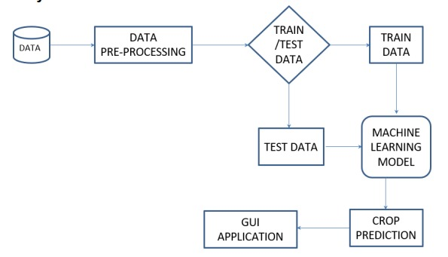
CROP YIELD FORECASTING USING MACHINE LEARNING
Department of Computer Science & Engineering
School of Computing
10214CS602 – MINOR PROJECT II
WINTER SEMESTER 2023-2024
ABSTRACT
INTRODUCTION
The impact of climate change in India, majority of the agricultural crops are being badly affected in terms of their performance over a period of last two decades. Predicting the crop yield well ahead of its harvest would help the policy makers and farmers for taking appropriate measures for marketing and storage. Such predictions will also help the associated industries for planning the logistics of their business. Several methods of predicting and modeling crop yields have been developed in the past with varying rate of success, as these don’t take into account characteristics of the weather, a n d are mostly empirical. In the present study a software tool named ‘Crop Advisor’ has been developed as an user friendly web page for predicting the influence of climatic parameters on the crop yields.C4.5 algorithm is used to find out the most influencing climatic parameter on the crop yields of selected crops in selected districts of Madhya Pradesh. This software provides an indication of relative influence of different climatic parameters on the crop yield.
Agriculture is fundamental to human survival. For populated developing
countries like India, it is even more imperative to increase the productivity of
crops, fruits and vegetables. Not only productivity, the quality of produce needs to stay high for better public health. However, both productivity and quality of food gets hampered by factors such as spread of diseases that could have been prevented with early diagnosis. Many of these diseases are infectious leading to total loss of crop yield. Given the vast geographical spread of agricultural lands , low education levels of farmers coupled with limited awareness and lack of access to plant pathologists, human assisted disease diagnosis is not effective and cannot keep up with the exorbitant requirements. To overcome the shortfall of human assisted disease diagnosis, it is imperative to build automation around crop disease diagnosis with technology and introduce low cost and accurate machine assisted diagnosis diagnosis, it is imperative to build automation around crop disease diagnosis with technology and introduce low cost and accurate machine easily access
Fig : Input Image For Processing
Fig: Data flow Diagram
METHODOLOGIES
STANDARDS AND POLICIES
Step 1 : Upload Paddy Crop Dataset
• using this module we will upload dataset to application
• Preprocess Dataset in above dataset we can see we have numeric and non-numeric values and deep learning algorithms only take numeric data so we need to process dataset to remove missing and non-numeric values so by using this model we will remove such data.
Step 2 : Train RNN Algorithm
• Now process data will be input to RNN algorithm to trained crop yield prediction model
Step 3 : Run Proposed DQN Model:
this algorithm environment/AGENT function will initialize RNN model and then its STATE will read test data and call ACTION to perform prediction and based on predicted accuracy rewards or penalty will be applied.
The system use the set of policies and service of customer and database consumer privacy law and regulation may protect an individual animals and there belief from the loss of failure and privacy in the decline and the private customer in the order.
CONCLUSIONS
the project on "CROP YIELD FORECASTING USING MACHINE LEARNING" represents a significant stride towards revolutionizing agricultural practices. The integration of advanced deep reinforcement learning techniques for crop yield prediction not only bridges existing gaps in conventional methods but also aligns with the imperative of sustainability in modern agriculture.
The literature review underscored the necessity for sophisticated models capable of adapting to the dynamic nature of agrarian environments. The project responds to this need by developing a model that leverages deep reinforcement learning, allowing it to learn and optimize predictions over time, considering factors such as climate, soil quality, and crop management practices.
Fig : Output Image After Processing
TEAM MEMBER DETAILS
Vtu 20114/C. Yella Krishna Reddy
Vtu 20113/C. Yella Nagi Reddy
Vtu 19969/T. Sai Kumar Reddy
6304251008
6302955947
9100102967
1. vtu20114@veltech.edu.in
2. vtu20113@veltech.edu.in
3. vtu19969@veltech.edu.in
RESULTS
ACKNOWLEDGEMENT
As the project progresses, its potential to empower farmers with predictive insights for optimizing crop yields while adhering to sustainability principles becomes increasingly evident. The outcomes are anticipated to go beyond academic contributions, fostering positive changes in agricultural landscapes, promoting resource efficiency, and supporting global efforts towards sustainable food production.
Supervisor Name : Mrs.J.Swapna/ Assistant Professor
Phone Number: 9585674456
Email:swapna@velteh.edu.in
Fig :System Architecture

